Slide 1


GitHub Live Demo
Hagar Elgabry 05/31/2022

Slide 2
AGENDA
1
What is the Architecture of Git
2
What is GitHub?
3
GitHub Live Demo

Slide 3
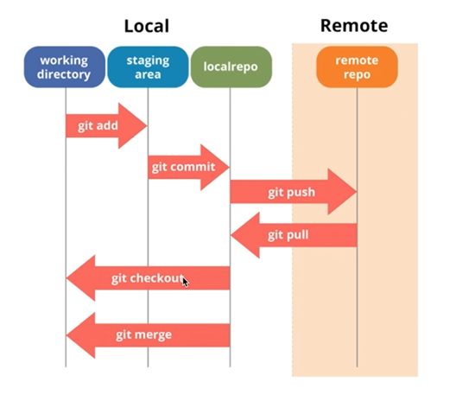
The Architecture of Git

Slide 4
What is GitHub?
GitHub.com is a website to upload your repositories online
Provides Backup and visual interface to your repo
GIT != GitHub

Slide 5


Slide 6


THANK YOU

